Slide 1

E-COMMERCE
ANALYSIS WITH
GOOGLE MARKETPLACE
JUSTINE PICAR, OCTOBER 2021

Slide 2

BUSINESSES AND E-COMMERCE: PROBLEM
Businesses fail due to:
Lack of research
Not the right market
Not reaching the right people
21.5% fail within the 1st year
30% fail within the 2nd year
50% fail within the 5th year
70% fail within the 10th year
For online businesses, 90% fail within 4 months

Slide 3
PROJECT OBJECTIVE:
Identify what metrics will improve profits for online stores by exploring and analyzing user propensity to purchase and provide recommendations for maintaining customer loyalty and mitigating attribution issues

Slide 4



DATA: GOOGLE MERCHANDISE DATA FROM BIGQUERY REST API
INCLUDES TRAFFIC SOURCE, CONTENT, TRANSACTIONAL DATA
CONSTRAINTS: HIDDEN, REMOVED, AND/OR DEPRECATED FIELDS
DATA CAN ONLY BE QUERIED OR USED TO GENERATE REPORTS

Slide 5
DATA WRANGLING
Used Standard SQL to query the data
Identified useful features:
fullVisitorId
date
visits or sessions
hits
pageviews
bounces
sessionQuality
timeOnSite (in seconds)
Unnested totals column to aggregate the features by day over the course of two weeks and create new features
Binary Target Variable (Transactions)
Features broke out in the following format from 12am to 11:59pm:
Day 0 - day of purchase
Day 1 - 1 day before purchase
Day 2 - 2 days before purchase
Day 3 - 3 days before purchase
Day 4-6 - 4-6 days before purchase
Week 2 - 2 weeks before purchase
Total of ~20k values for train set, ~19k validation set with 38 total columns
Training Set from 07/1/2017 - 07/31/2017
Test Set from 03/1/2017 - 03/14/2017
Each feature is grouped by a distinct and unique visitor id over 10 days

Slide 6
PACKAGES
For preprocessing, modeling the data, and calculating metrics
sklearn
For data and metric visualization
matplotlib.pyplot
skplot
seaborn
shap
For querying the data from API to jupyter notebook
google.cloud

Slide 7
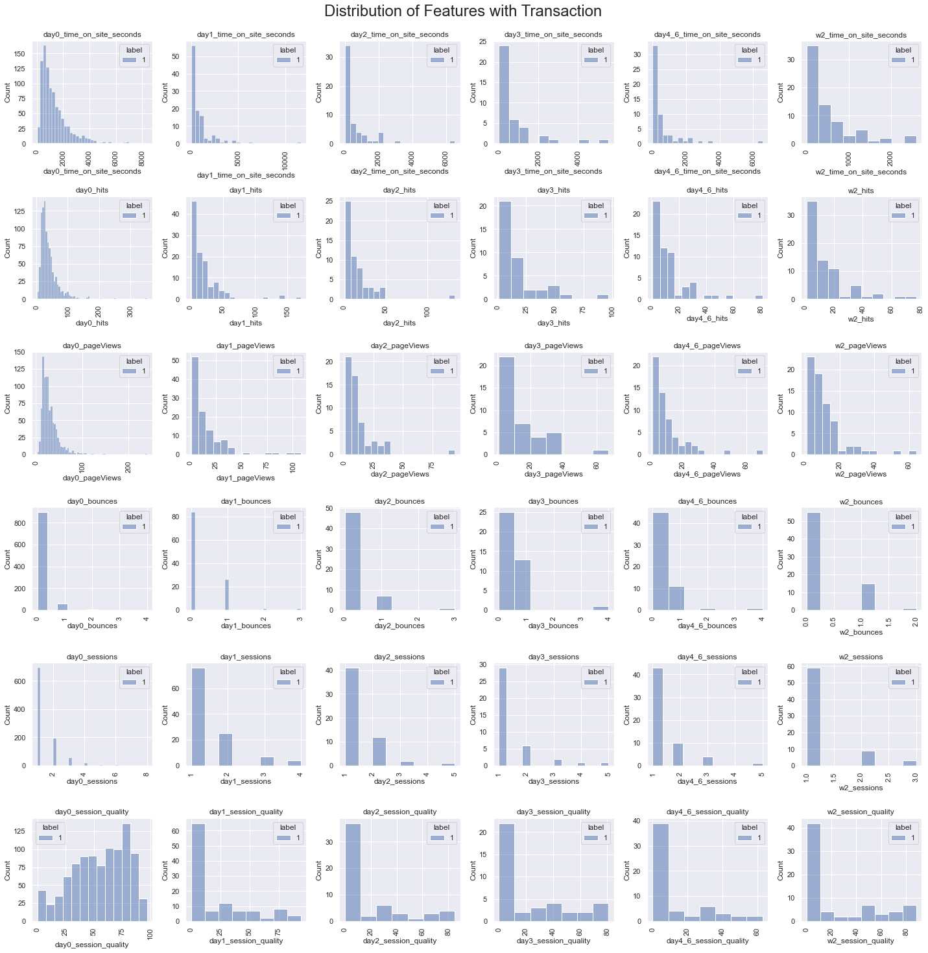
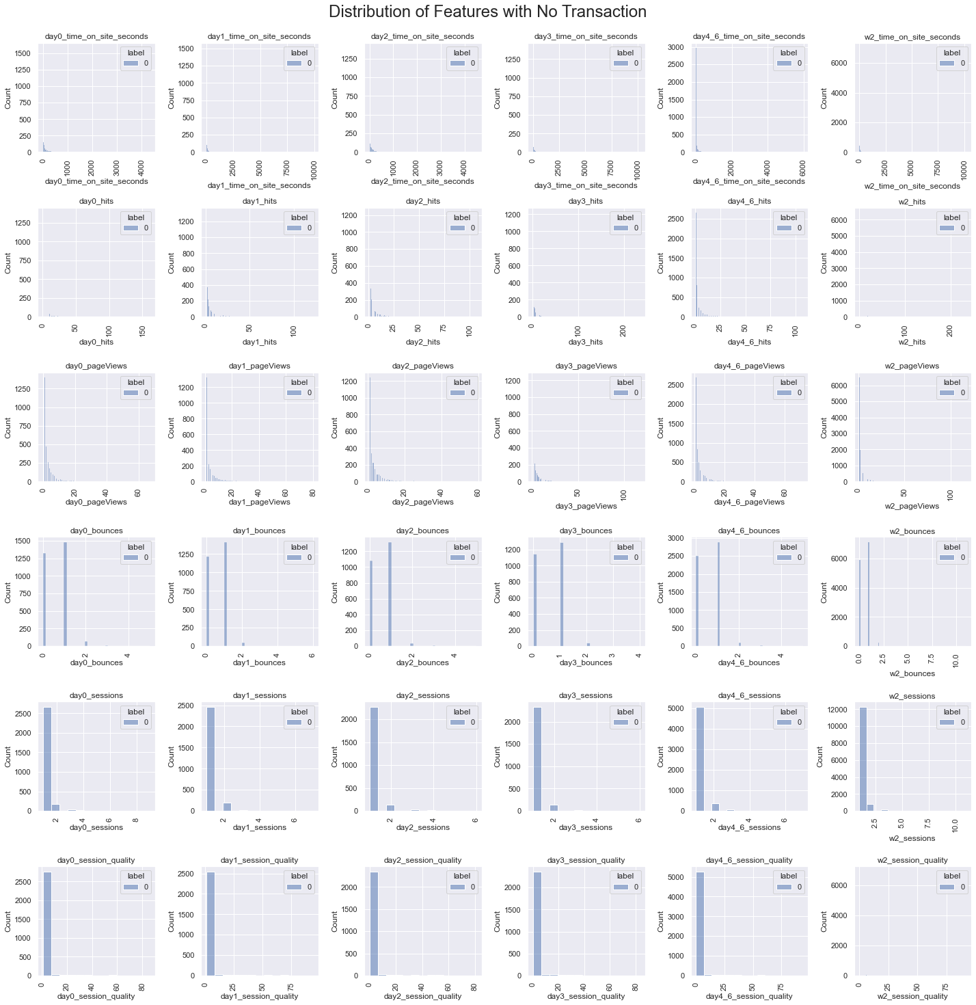
EXPLORATORY DATA ANALYSIS: DISTRIBUTIONS

Slide 8
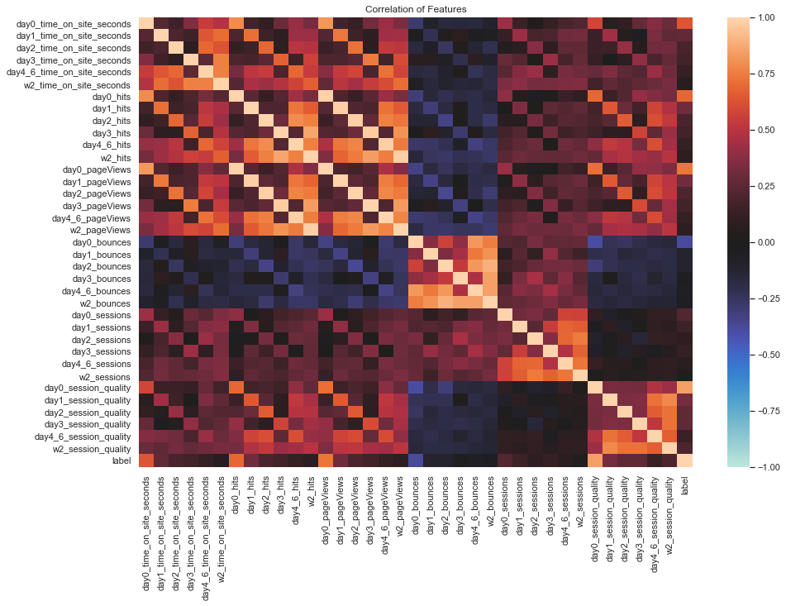
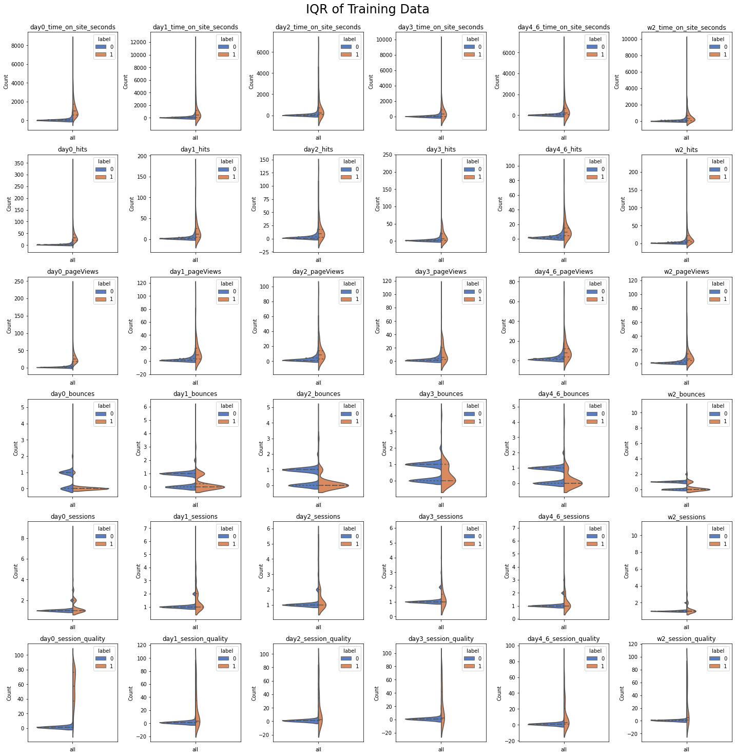
EXPLORATORY DATA ANALYSIS: FEATURE IMPORTANCE AND IQR

Slide 9
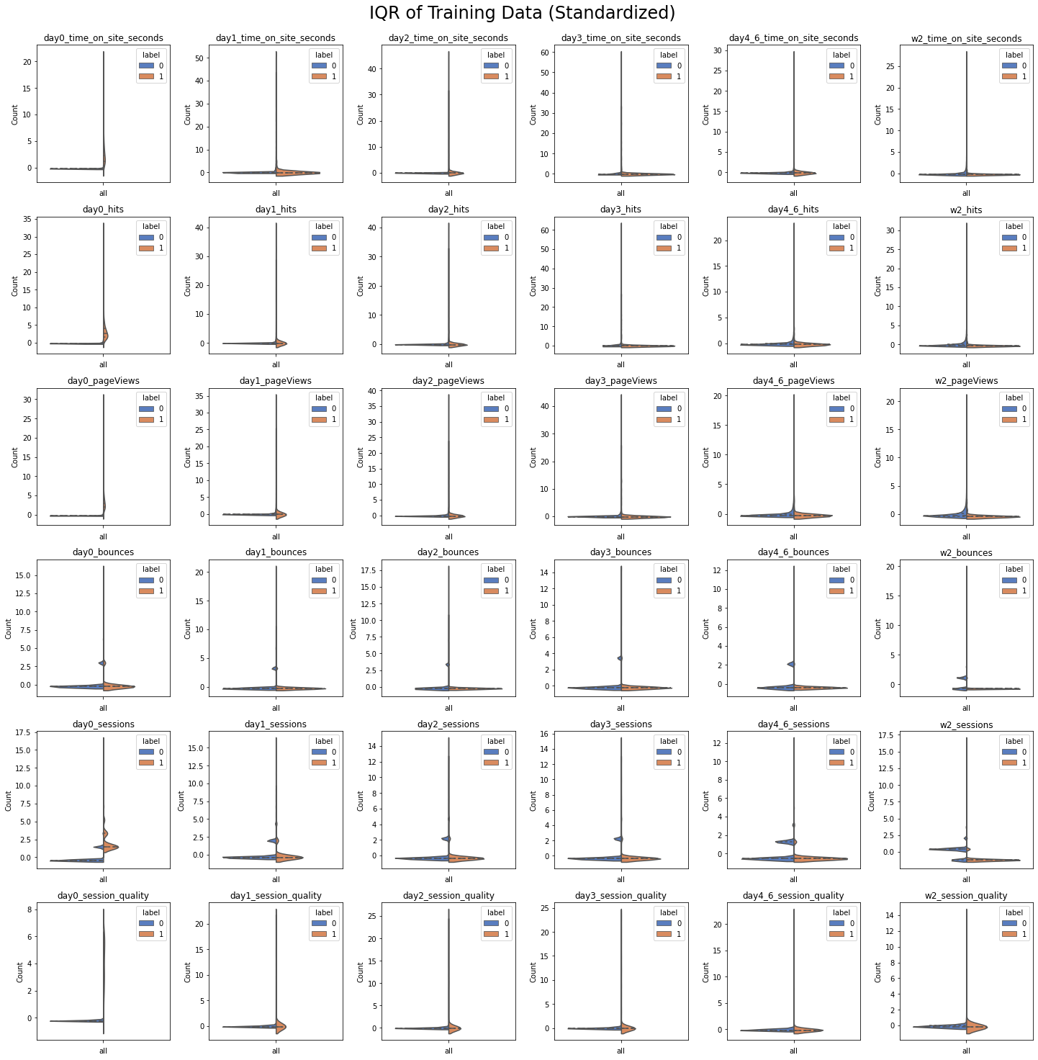
PRE-PROCESSING: SCALING AND IMPUTING THE DATA
Increase robustness of models and ability to generalize data
Only 5% of data are true transactions; highly skewed
Normalize data with Standardization
Impute null values with zero (this represents time spent on site when visitor was not present)

Slide 10
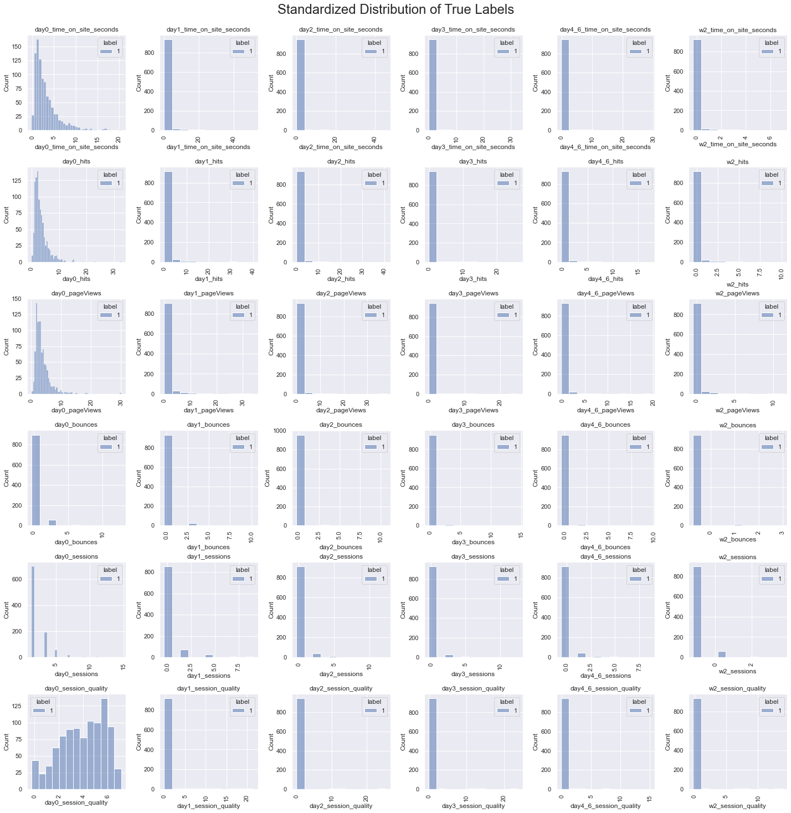
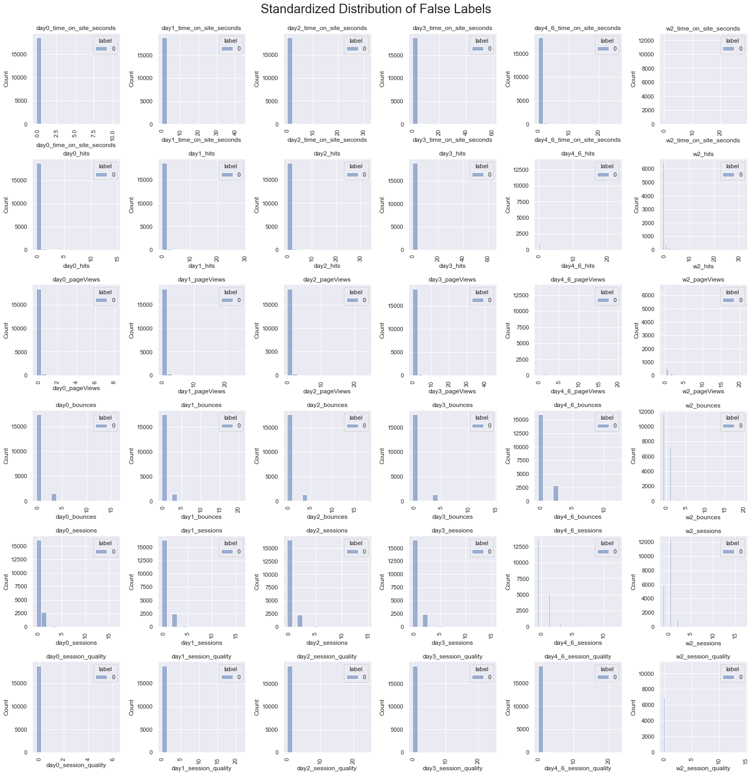
PRE-PROCESSING: SCALING DISTRIBUTION OF DATA

Slide 11
Methodology
Depending on the goals of the company, certain features included may be dropped or added as needed
The model in its current form is simplified
Has no consideration for platform constraints which would need to be defined by the company
Models used:
CatBoost
Logistic Regression
Random Trees
Metrics considered
SHAP value (impact on model output) for CatBoost or feature importance on Random Forest and Logistic Regression
True Positive Rate from the ROC curve
LIFT score for customer segmentation

Slide 12
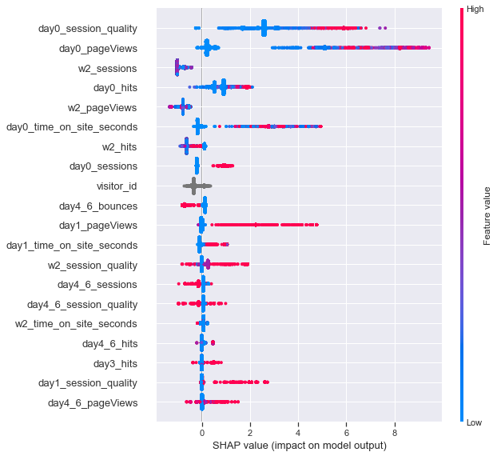
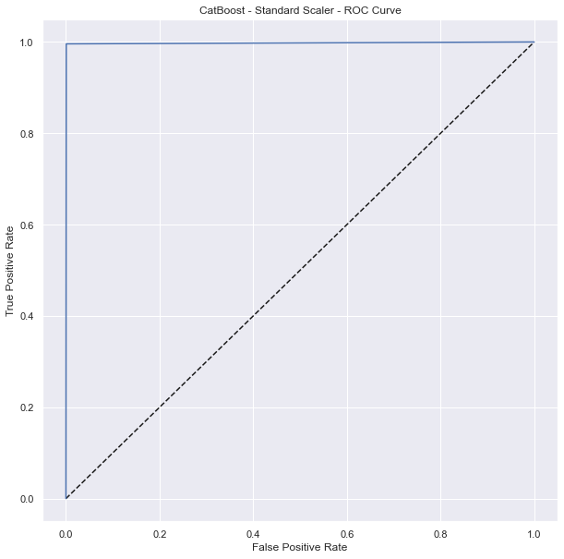
MODELING: CATBOOST, ACCURACY: 99.91%

Slide 13
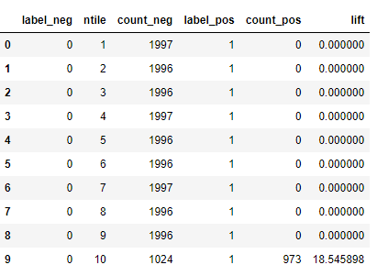
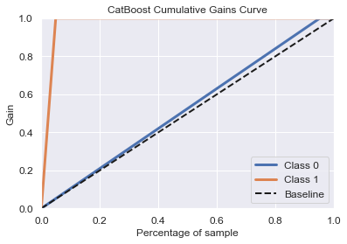
MODELING: CATBOOST, ACCURACY: 99.91%

Slide 14
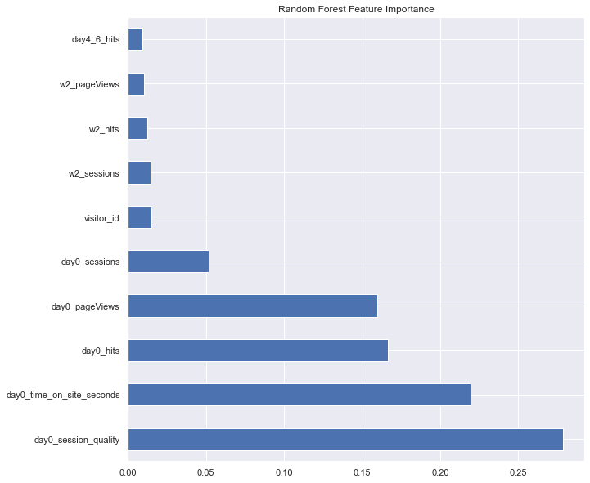

MODELING: RANDOM FOREST, ACCURACY: 99.99%

Slide 15
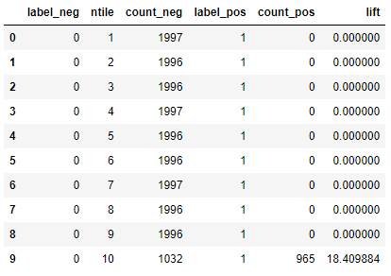
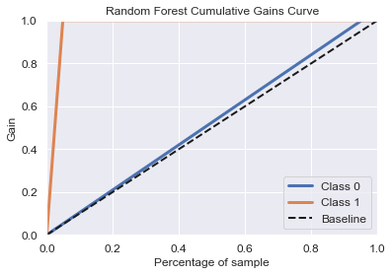
MODELING: RANDOM FOREST, ACCURACY: 99.99%

Slide 16
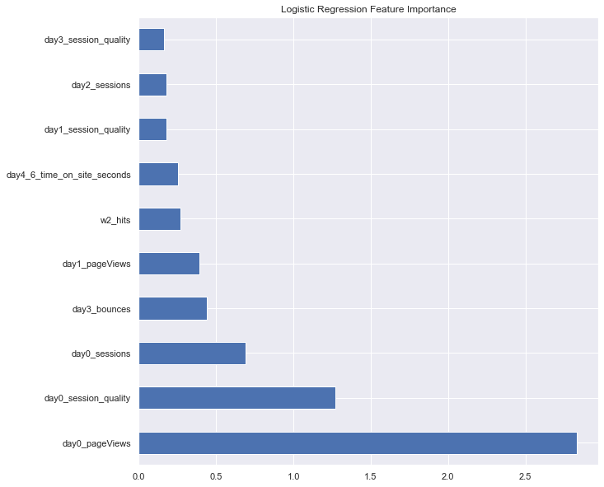
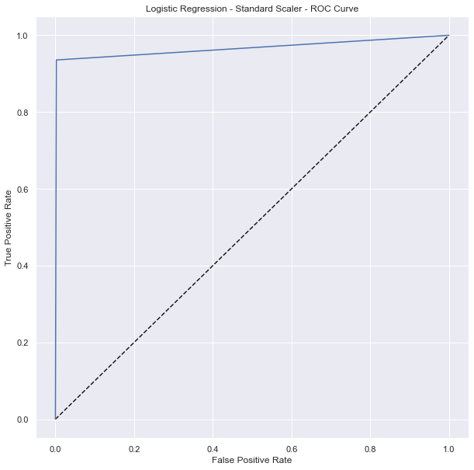
MODELING: LOGISTIC REGRESSION, ACCURACY: 100%

Slide 17
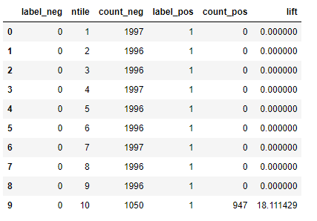

MODELING: LOGISTIC REGRESSION, ACCURACY: 100%

Slide 18
RESULTS AND ANALYSIS
BEST MODEL: CATBOOST
Highest lift score, successfully identified most users who purchase
True Positive Rating similar to Random Forest Model
Random Forest lift function is lower
WORST MODEL: LOGISTIC REGRESSION
100% accuracy, but lowest lift score and lowest true positive rating
Suggests there may be overfitting occuring
Feature Importance:
Users engagement increases as they approach the purchase date (day0 features); transactions and activities are highly correlated to the day of purchase
Page views, session quality, and time on site have the highest positive correlations
Bounces have a negative correlation

Slide 19
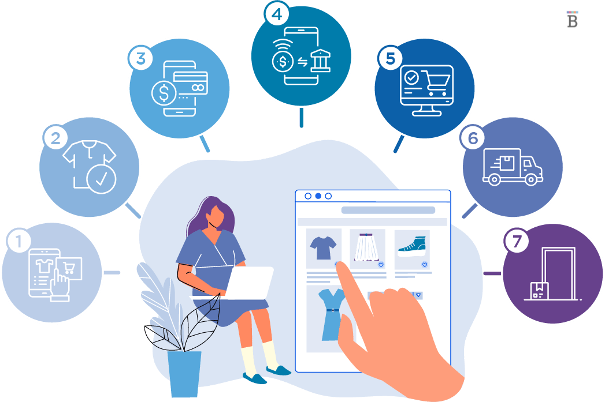
APPLICATIONS
Identify segments of users likely to organically convert
Allocate budget to market to this segment and mitigate attribution
Optimize email and marketing campaigns to specific users
Provide discounts for other segments less likely to convert
Encourage users to make purchases
Paid media marketing campaigns (on Amazon, Facebook, Instagram, etc.)
Customer Service: Reroute and prioritize calls based on user’s propensity to purchase

Slide 20
CONCLUSION & LESSONS LEARNED
99.91% ACCURACY ON CATBOOST MODEL (note: for purpose of justifying roc, lift, other metrics, etc)
PRE-PROCESSING
Upsampling smaller labels
Imputing mean or median
Normalize using min-max scale or log transformation
MODELING:
ADA BOOST
XG BOOST
SELECT MORE FEATURES FROM BIGQUERY TO EXPLORE

Slide 21
THANK YOU!
Thank you Nik for being my mentor! It’s been wonderful working with you.

Slide 22
SOURCES
https://www.investopedia.com/articles/personal-finance/040915/how-many-startups-fail-and-why.asp
https://www.lendingtree.com/business/small/failure-rate/
https://www.huffpost.com/entry/10-reasons-why-your-new-online-business-will-fail_b_7053610
https://console.cloud.google.com/marketplace/product/obfuscated-ga360-data/obfuscated-ga360-data?project=lexical-script-761
https://support.google.com/analytics/answer/3437719?hl=en
Stack Overflow
https://www.analyticsvidhya.com/blog/2017/08/catboost-automated-categorical-data/

